Slide 1
Stress 3
Daily Hassles

Slide 2
Syllabus
Stress in everyday life
Life changes and daily hassles as sources of stress
Workplace stress including the effects of workload and control
Personality factors, including Type A and Type B behaviour, hardiness
Psychological and biological methods of stress management, including stress inoculation therapy and drug therapy

Slide 3
Life changes and daily hassles as sources of stress

Slide 4
Life events
Think of some.
What is the most stressful.

Slide 5
Life events
Think of some.
  Marriage, death, moving house, marriage, Christmas?
What is the most stressful.
  Death in the family, moving house. Your perception of the stressor, your perceived ability to cope with it

Slide 6
Measuring stress
Self report Questionnaires. Quantitative and Qualitative (How stressed so you feel).
Example: DASS: depression, anxiety and stress scale
Do not do this. WHY?
Interviews. (trained interviewer)

Slide 7
Holmes and Rahe
Life change Units: Asked 394 people to rate 43 life events against marriage. Marriage given a score of 500 and then higher or lower.
Look at saved PDF. Called the Social readjustment rating scale. (SRRS)

Slide 8
Problems
USA study - discuss

Slide 9
Retrospective analysis
People with heart disease and stress related illness given the test. There was a positive correlation. (Rahe and Lind)
A prospective study carried out by Rahe et al.
Weak positive correlation found.

Slide 10
Problems
Study used US navy personnel.
Causality no association.
What is stress related illness?
Individual differences.

Slide 11
Daily Hassles
Evans and Edgerton
Negative daily events to colds developing.
Look at daily hassles

Slide 12
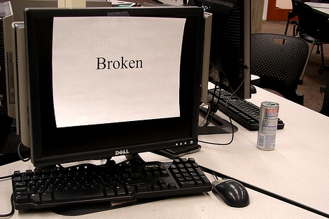
What is a daily hassle?
A daily hassle is a minor event that arises in
the course of a normal day
They are usually short-lived but they may
linger if left unresolved and the ‘after-effects’
of unresolved issues may then intensify over
time as they accumulate with subsequent hassles

Slide 13
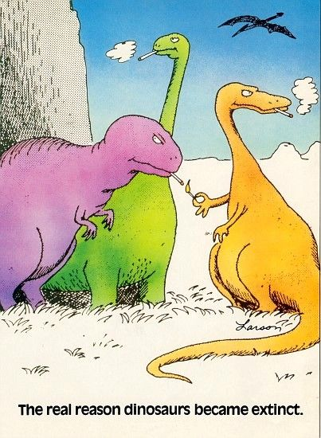
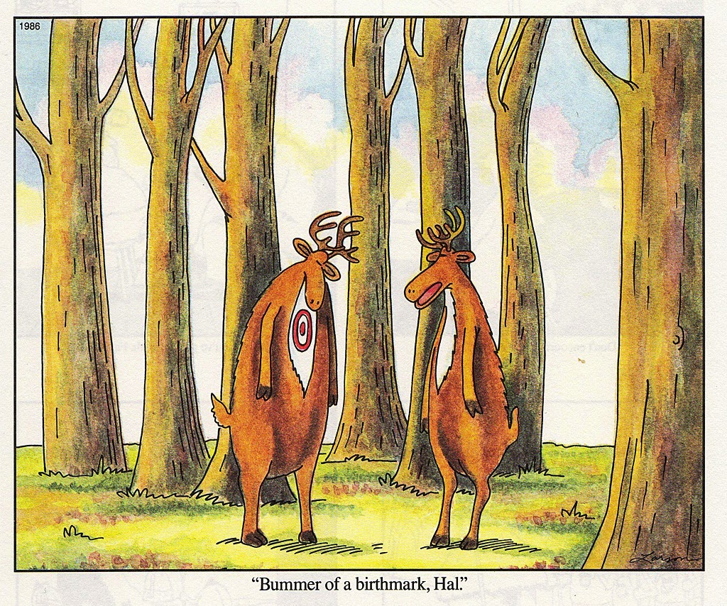
What is a daily uplift?
A daily uplift is a positive, desirable experience that makes a daily hassle more bearable

Slide 14
Psychological sources of stress: Daily Hassles & Uplifts
There is a problem with Holmes & Rahe’s view that life events cause stress:
Lazarus et al. believed that Life events are by their very nature unusual, they are major events that not everyone experiences – the DAILY HASSLES of life can also be a source of stress E.g. Losing car keys, worrying about friendships, concerns over appearance, keeping up with college may have more impact than the items on the SRRS.
They also thought that positive life events known as ‘uplifts’ are important, and these counteract the stress caused by daily hassles E.g. good relationships, to partner, friends, completing a task

Slide 15
Lazarus et al. (1981) Hassles Scale To assess hassles sources of stress
This scale was developed by Lazarus et al. to measure this they developed a scale which contained the following items: Hassles Scale: 117 items on the scale E.g. concerns about weight, health of family member, too many things to do, misplacing or losing things
They thought that positive life events can reduce the impact of these Uplifts Scale; 135 items that cheer people up e.g. good relationships, to partner, friends, completing a task, feeling healthy, getting enough sleep, eating out, visiting, phoning or writing to someone.

Slide 16
Comparing Life events & daily hassles as sources of stress:
DeLongis et al. (1982) They compared participants Hassles scores with Life Events, and found that both correlated with health status. The association for hassles scores was higher However, No relationship was found between uplift scores and health outcomes

Slide 17
Evaluation of research using life events and hassles/ uplift scales
The research using these scales support the idea that there are many sources of stress in life – and they can effect physical and psychological health
Correlations are not huge, but they are often significant. This means that in a general sense stress can potentially effect our health and how we operate from day to day

Slide 18
Exam Question
Outline and evaluate research into life changes and/or daily hassles as sources of stress. (12)

Slide 19
Answer
Research into life changes can focus on the work of Holmes and Rahe in developing the SRRS as well as into the use of the scale by Rahe et al. Several psychologists have investigated daily hassles as a source of stress, such as Lazarus; Kanner et al; De Longis et al. If daily hassles are described credit can be given to the ideas about frequency, duration and intensity (the accumulation and amplification effects).
Credit can be given for a description of theory/model or studies. If studies are used there are different ways of approaching this question. Students can focus on the methodology or findings; they can describe one study in detail or more than one but in less detail.
Students can outline either life changes or daily hassles or both, but clearly there will be a breadth/depth trade-off here depending on which way they approach this question. (One in more detail, more than one but in less detail.)
NB Examiners should be aware that there is a whole range of studies which can receive credit.
AO2: The evaluation can come from a consideration of methodological issues: use of self-report scales, retrospective data, correlations, population validity. Students can also use one to evaluate the other, for example, some psychologists argue that daily hassles are a better predictor of stress-related illness than are life changes.

Slide 20
Workplace stress including the effects of workload and control
Environment – workplace, heating, lighting, etc..
Home-work interface: Work life balance
Control (decision latitude) over their workload.
Workload – too much or even too little.

Slide 23
Karasek Model of the relationship between demand (workload), control (decision latitude) and job strain (stress)
 | High Demand | Low Demand
Low control | High strain job (vulnerable to stress) | Passive job
High control | Active Job | Low strain job
Relationships can be modified by other factors, such as social support.

Slide 24
Whitehall studies
Marmot et al.
Whitehall 1: Lower paid = twice the illness and mortality rate.
Whitehall 2 showed similar results with a significant factor being the decision latitude.

Slide 25
Issues with experiment
Methodological issues
  Based on self-report questionnaires (may have underestimated risk factors such as smoking)
  Missing factors (congenital heart problems)
  Government Civil servants.
Ethical
  Debrief
  Support if ill.

Slide 26
Lots of studies
There are many studies that have found a similar relationship Fox et al = nurses.

Slide 27
Dealing with workplace stress.
Measure: The occupational stress indicator (Cooper et al). Then make individual tailored stress management program.

Slide 28
Describe one research study that has investigated stress in the workplace. In your answer you should include details of what was done and what was found.

Slide 29
Answer
Possible research could include Marmot’s research into stress in civil servants; Johansson’s study of Swedish sawmill workers, or any other study of workplace stress.

Slide 30
Lee and Denis were talking in the doctor’s waiting room. Denis remarked that his new neighbours were very noisy and that whenever he drove into town it was getting increasingly difficult to find anywhere to park. Lee said that his wife had died recently and that he was just about to retire.
Using examples from the conversation above, discuss the difference between life changes and daily hassles.

Slide 31
Answer
1 mark for using examples or naming Lee to explain Life Changes and 1 mark for using examples or naming Denis to explain Daily Hassles.
For example, Lee is experiencing Life Changes (1 mark).
Daily Hassles are things such as the problems with traffic (1 mark).
2 further marks for discussion of the difference.
Denis is suffering from frequent, minor, everyday events whereas Lee is suffering from infrequent, major events (2 marks).
Credit other psychologically informed elaboration of discussion of difference, for example reference to chronic/acute and links to stress.

